Slide 1

Session 3 Data Analytics Life Cycle
Model Building
Communicating Results and Findings
Operationalizing
Wrangling

Slide 2
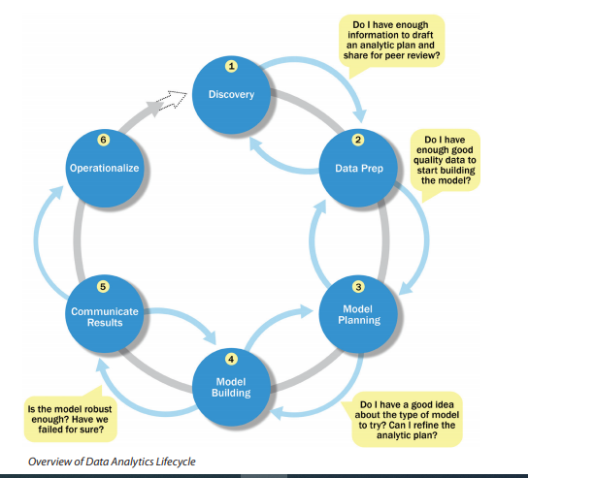
Data Analytics Life Cycle
The Data Analytics Lifecycle is designed specifically for Big Data problems and data science projects.
The lifecycle has six phases, and project work can occur in several phases at once.
For most phases in the lifecycle, the movement can be either forward or backward.
This iterative depiction of the lifecycle is intended to more closely portray a real project, in which aspects of the project move forward and may return to earlier stages as new information is uncovered and team members learn more about various stages of the project.
This enables participants to move iteratively through the process and drive toward operationalizing the project work.

Slide 3
Phase 1—Discovery
In Phase 1, the team learns the business domain, including relevant history such as whether the organization or business unit has attempted similar projects in the past from which they can learn.
The team assesses the resources available to support the project in terms of people, technology, time, and data.
Important activities in this phase include framing the business problem as an analytics challenge that can be addressed in subsequent phases and formulating initial hypotheses (IHs) to test and begin learning the data.
Phase 2—Data preparation: requires the presence of an analytic sandbox, in which the team can work with data and perform analytics for the duration of the project.
The team needs to execute extract, load, and transform (ELT) or extract, transform and load (ETL) to get data into the sandbox.
The ELT and ETL are sometimes abbreviated as ETLT.
Data should be transformed in the ETLT process so the team can work with it and analyze it.

Slide 4
Continue…
Phase 3—Model planning: where the team determines the methods, techniques, and workflow it intends to follow for the subsequent model building phase.
The team explores the data to learn about the relationships between variables and subsequently selects key variables and the most suitable models.
Phase 4—Model building: the team develops datasets for testing, training, and production purposes.
In addition, in this phase the team builds and executes models based on the work done in the model planning phase.
The team also considers whether its existing tools will suffice for running the models, or if it will need a more robust environment for executing models and workflows (for example, fast hardware and parallel processing, if applicable).
Phase 5—Communicate results: the team, in collaboration with major stakeholders, determines if the results of the project are a success or a failure based on the criteria developed in Phase 1.
The team should identify key findings, quantify the business value, and develop a narrative to summarize and convey findings to stakeholders.
Phase 6—Operationalize: the team delivers final reports, briefings, code, and technical documents.
In addition, the team may run a pilot project to implement the models in a production environment.

Slide 5
Phase 4: Model Building
In this Phase , the team develops datasets for testing, training, and production purposes.
In addition, in this phase the team builds and executes models based on the work done in the model planning phase.
The team also considers whether its existing tools will suffice for running the models, or if it will need a more robust environment for executing models and workflows (for example, fast hardware and parallel processing, if applicable).
During this process, it is critical to ensure that the training and test datasets are sufficiently robust for the model and analytical techniques.
A simple way to think of these datasets is to view the training dataset for conducting the initial experiments and the test sets for validating an approach once the initial experiments and models have been run.

Slide 6
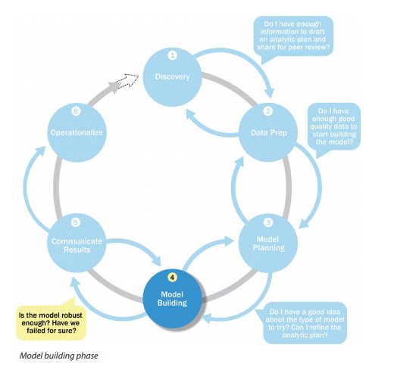
Continue…
In the model building phase, shown in figure, an analytical model is developed and fit on the training data and evaluated (scored) against the test data.

Slide 7
Continue…
Creating robust models that are suitable to a specific situation requires thoughtful consideration to ensure the models being developed ultimately meet the objectives outlined in Phase 1.
Questions to consider include these:
● Does the model appear valid and accurate on the test data?
● Does the model output/behavior make sense to the domain experts? That is, does it appear as if the model is giving answers that make sense in this context?
● Do the parameter values of the fitted model make sense in the context of the domain?
● Is the model sufficiently accurate to meet the goal?
● Does the model avoid intolerable mistakes? Depending on context, false positives may be more serious or less serious than false negatives, for instance. (Are more data or more inputs needed? Do any of the inputs need to be transformed or eliminated?
● Will the kind of model chosen support the runtime requirements?
● Is a different form of the model required to address the business problem? If so, go back to the model planning phase and revise the modeling approach. Once the data science team can evaluate either if the model is sufficiently robust to solve the problem or if the team has failed, it can move to the next phase in the Data Analytics Lifecycle.

Slide 8
Tools: Model Building Phase
Commercial Tools:
SAS Enterprise Miner: allows users to run predictive and descriptive models based on large volumes of data from across the enterprise. It interoperates with other large data stores, has many partnerships, and is built for enterprise-level computing and analytics.
SPSS Modeler: (provided by IBM and now called IBM SPSS Modeler) offers methods to explore and analyze data through a GUI.
Matlab: provides a high-level language for performing a variety of data analytics, algorithms, and data exploration.
Alpine Miner: provides a GUI front end for users to develop analytic workflows and interact with Big Data tools and platforms on the back end.
STATISTICA and Mathematica : are also popular and well-regarded data mining and analytics tools.
Free or Open Source tools:
R and PL/R: R was described earlier in the model planning phase, and PL/R is a procedural language for PostgreSQL with R. Using this approach means that R commands can be executed in database. This technique provides higher performance and is more scalable than running R in memory.
Octave: a free software programming language for computational modeling, has some of the functionality of Matlab. Because it is freely available, Octave is used in major universities when teaching machine learning.
WEKA: is a free data mining software package with an analytic workbench. The functions created in WEKA can be executed within Java code.
Python is a programming language that provides toolkits for machine learning and analysis, such as scikit-learn, numpy, scipy, pandas, and related data visualization using matplotlib.
SQL in-database implementations, such as MADlib provide an alterative to in-memory desktop analytical tools. MADlib provides an open-source machine learning library of algorithms that can be executed in-database, for PostgreSQL or Greenplum.

Slide 9
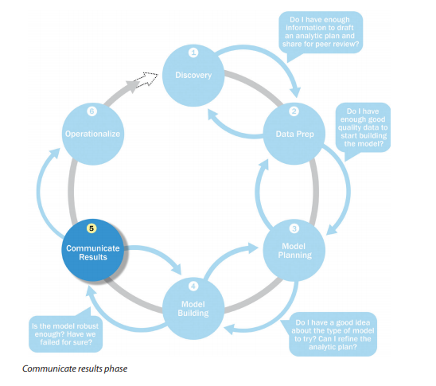
Phase 5: Communicate Results and finding
In this phase, the team, in collaboration with major stakeholders, determines if the results of the project are a success or a failure based on the criteria developed in Phase 1.
The team should identify key findings, quantify the business value, and develop a narrative to summarize and convey findings to stakeholders.
After executing the model, the team needs to compare the outcomes of the modeling to the criteria established for success and failure.
In figure, the team considers how best to articulate the findings and outcomes to the various team members and stakeholders, taking into account caveats, assumptions, and any limitations of the results.
Because the presentation is often circulated within an organization, it is critical to articulate the results properly and position the findings in a way that is appropriate for the audience.

Slide 10
Phase 6: Operationalize
In this phase, the team delivers final reports, briefings, code, and technical documents.
In addition, the team may run a pilot project to implement the models in a production environment.
In the final phase, the team communicates the benefits of the project more broadly and sets up a pilot project to deploy the work in a controlled way before broadening the work to a full enterprise or ecosystem of users.
In model building phase, the team scored the model in the analytics sandbox.
Phase 6, shown in Figure, represents the first time that most analytics teams approach deploying the new analytical methods or models in a production environment.
Rather than deploying these models immediately on a wide-scale basis, the risk can be managed more effectively and the team can learn by undertaking a small scope, pilot deployment before a wide-scale rollout.
This approach enables the team to learn about the performance and related constraints of the model in a production environment on a small scale and make adjustments before a full deployment.
During the pilot project, the team may need to consider executing the algorithm in the database rather than with in-memory tools such as R because the run time is significantly faster and more efficient than running in-memory, especially on larger datasets.

Slide 11
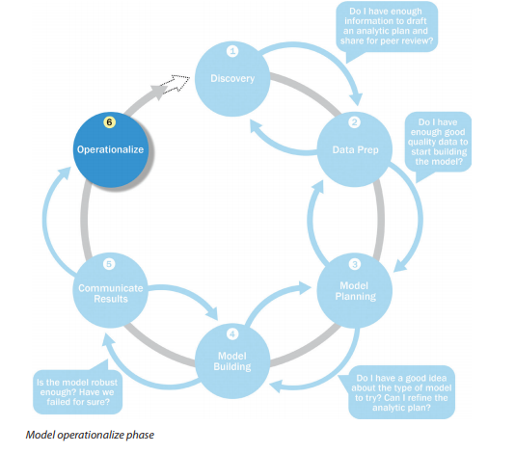
Phase 6: Operationalize

Slide 12
Data science in big data world
Benefits and uses of data science
Facets of data
Data science process

Slide 13
Data science in big data world
Big data is a blanket term for any collection of data sets so large or complex that it becomes difficult to process them using traditional data management techniques such as, for example, the RDBMS (relational database management systems).
The widely adopted RDBMS has long been regarded as a one-size-fits-all solution, but the demands of handling big data have shown otherwise.
Data science involves using methods to analyze massive amounts of data and extract the knowledge it contains. You can think of the relationship between big data and data science as being like the relationship between crude oil and an oil refinery
Data science and big data evolved from statistics and traditional data management but are now considered to be distinct disciplines.

Slide 14
Continue…
The characteristics of big data are often referred to as three Vs:
Volume
How much data is there?
Variety
How diverse are different types of data?
Velocity
At what speed is new data generated?

Slide 15
1. Benefits and uses of data science
Data science and big data are used almost everywhere in both commercial and noncommercial settings.
Commercial companies in almost every industry use data science and big data to gain insights into their customers, processes, staff, completion, and products.
Many companies use data science to offer customers a better user experience, as well as to cross-sell, up-sell, and personalize their offerings.
Example 1:Google AdSense, which collects data from internet users so relevant commercial messages can be matched to the person browsing the internet.
Example 2: MaxPoint (http://maxpoint.com/us) Benefits and uses of data science and big data 3 is another example of real-time personalized advertising.
Human resource professionals use people analytics and text mining to screen candidates, monitor the mood of employees, and study informal networks among coworkers.
Governmental organizations are also aware of data’s value.
Many governmental organizations not only rely on internal data scientists to discover valuable information, but also share their data with the public.

Slide 16
Benefits and uses of data science
Nongovernmental organizations (NGOs) are also no strangers to using data.
They use it to raise money and defend their causes.
The World Wildlife Fund (WWF), for instance, employs data scientists to increase the effectiveness of their fundraising efforts.
Many data scientists devote part of their time to helping NGOs, because NGOs often lack the resources to collect data and employ data scientists.
Data Kind is one such data scientist group that devotes its time to the benefit of mankind.
Universities use data science in their research but also to enhance the study experience of their students.
The rise of massive open online courses (MOOC) produces a lot of data, which allows universities to study how this type of learning can complement traditional classes.
MOOCs are an invaluable asset if you want to become a data scientist and big data professional,
so definitely look at a few of the better-known ones: Coursera, Udacity, and edX.
The big data and data science landscape changes quickly, and MOOCs allow to stay up to date by following courses from top universities.

Slide 17
2. Facets of data
In data science and big data different types of data will be used, and each of them tends to require different tools and techniques.
The main categories of data are
Structured
Unstructured
Natural language
Machine-generated
Graph-based
Audio, video, and images
Streaming

Slide 18
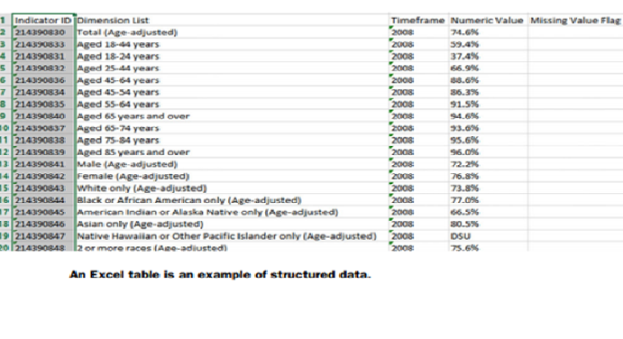
1. Structured data
Structured data is data that depends on a data model and resides in a fixed field within a record.
As such, it’s often easy to store structured data in tables within databases or Excel files shown in figure.
SQL, or Structured Query Language, is the preferred way to manage and query data that resides in database.

Slide 19
2. Unstructured Data
Unstructured data is data that isn’t easy to fit into a data model because the content is context-specific or varying.
Example of unstructured data is regular email (figure).
Although email contains structured elements such as the sender, title, and body text, it’s a challenge to find the number of people who have written an email complaint about a specific employee because so many ways exist to refer to a person, for example.
The thousands of different languages and dialects out there further complicate this.
A human-written email, as shown in figure, is also a perfect example of natural language data.

Slide 20
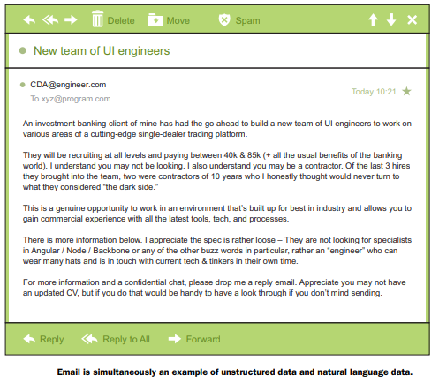
Unstructured Data

Slide 21
3. Natural language
Natural language is a special type of unstructured data;
it’s challenging to process because it requires knowledge of specific data science techniques and linguistics.
The natural language processing community has had success in entity recognition, topic recognition, summarization, text completion, and sentiment analysis, but models trained in one domain don’t generalize well to other domains.

Slide 22
4. Machine-generated data
Machine-generated data is information that’s automatically created by a computer, process, application, or other machine without human intervention.
Machine-generated data is becoming a major data resource and will continue to do so.
Wikibon has forecast that the market value of the industrial Internet (a term coined by Frost & Sullivan to refer to the integration of complex physical machinery with networked sensors and software) will be approximately $540 billion in 2020.
IDC (International Data Corporation) has estimated there will be 26 times more connected things than people in 2020.
This network is commonly referred to as the internet of things.
The analysis of machine data relies on highly scalable tools, due to its high volume and speed.

Slide 23
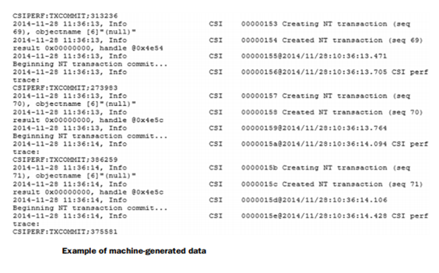
Continue…
Examples of machine data are web server logs, call detail records, network event logs, and telemetry (figure).

Slide 24
5.Graph- based or network data
“Graph data” can be a confusing term because any data can be shown in a graph.
“Graph” in this case points to mathematical graph theory.
In graph theory, a graph is a mathematical structure to model pair-wise relationships between objects.
Graph or network data is, in short, data that focuses on the relationship or adjacency of objects.
The graph structures use nodes, edges, and properties to represent and store graphical data.
Graph-based data is a natural way to represent social networks, and its structure allows you to calculate specific metrics such as the influence of a person and the shortest path between two people.

Slide 25
Continue…
Examples of graph-based data can be found on many social media websites (figure).
Example 1: LinkedIn you can see who you know at which company.
Example 2: Follower list on Twitter is another example of graph-based data.
The power and sophistication comes from multiple, overlapping graphs of the same nodes.
For example, imagine the connecting edges here to show “friends” on Facebook.
Imagine another graph with the same people which connects business colleagues via LinkedIn.
Imagine a third graph based on movie interests on Netflix.
Overlapping the three different-looking graphs makes more interesting questions possible.
Graph databases are used to store graph-based data and are queried with specialized query languages such as SPARQL.
Graph data poses its challenges, but for a computer interpreting additive and image data, it can be even more difficult.

Slide 26
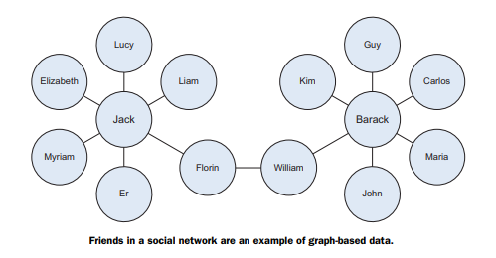
Continue…

Slide 27
6. Audio, image, and video
Audio, image, and video are data types that pose specific challenges to a data scientist.
Tasks that are trivial for humans, such as recognizing objects in pictures, turn out to be challenging for computers.
MLBAM (Major League Baseball Advanced Media) announced in 2014 that they’ll increase video capture to approximately 7 TB per game for the purpose of live, in-game analytics.
High-speed cameras at stadiums will capture ball and athlete movements to calculate in real time,
for example, the path taken by a defender relative to two baselines.
Recently a company called Deep Mind succeeded at creating an algorithm that’s capable of learning how to play video games.
This algorithm takes the video screen as input and learns to interpret everything via a complex process of deep learning.
It’s a remarkable feat that prompted Google to buy the company for their own Artificial Intelligence (AI) development plans.
The learning algorithm takes in data as it’s produced by the computer game; it’s streaming data.

Slide 28
7. Streaming data
While streaming data can take almost any of the previous forms, it has an extra property.
The data flows into the system when an event happens instead of being loaded into a data store in a batch.
Although this isn’t really a different type of data, we treat it here as such because you need to adapt process to deal with this type of information.
Examples are the “What’s trending” on Twitter, live sporting or music events, and the stock market.

